Slide 1

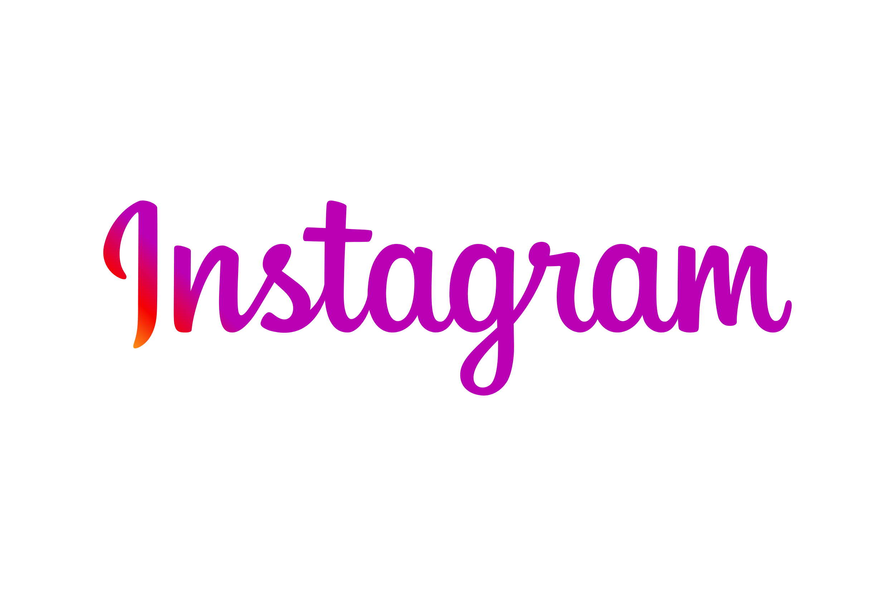

INSTAGRAM INSTAGRAM INSTAGRAM INSTAGRAM User ANALYTICS USER ANALYTICS USER ANALYTICS USER ANALYTICS
By- Abhishek Kumar ​

Slide 2
agenda
a
Project Description
Approach
Tech-Stack Used
Insights
Result

Slide 3
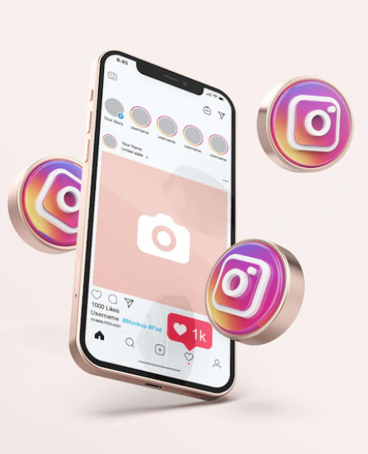
PROJECT DESCRIPTION
Finding business insights that can be used by teams across the business to launch a new marketing campaign, decide on features to build for an app, track the success of the app by measuring user engagement and improve the experience altogether while helping the business grow.

Slide 4
APPROACH
Database creation
Extraction of Insights
Created and inserted the values in the database using the DDL & DML SQL queries provided by the product manager(as per project) in the MySQL database using MySQL workbench.
After creating the database required insights are generated from the database tables by running SQL queries in MySQL workbench.

Slide 5
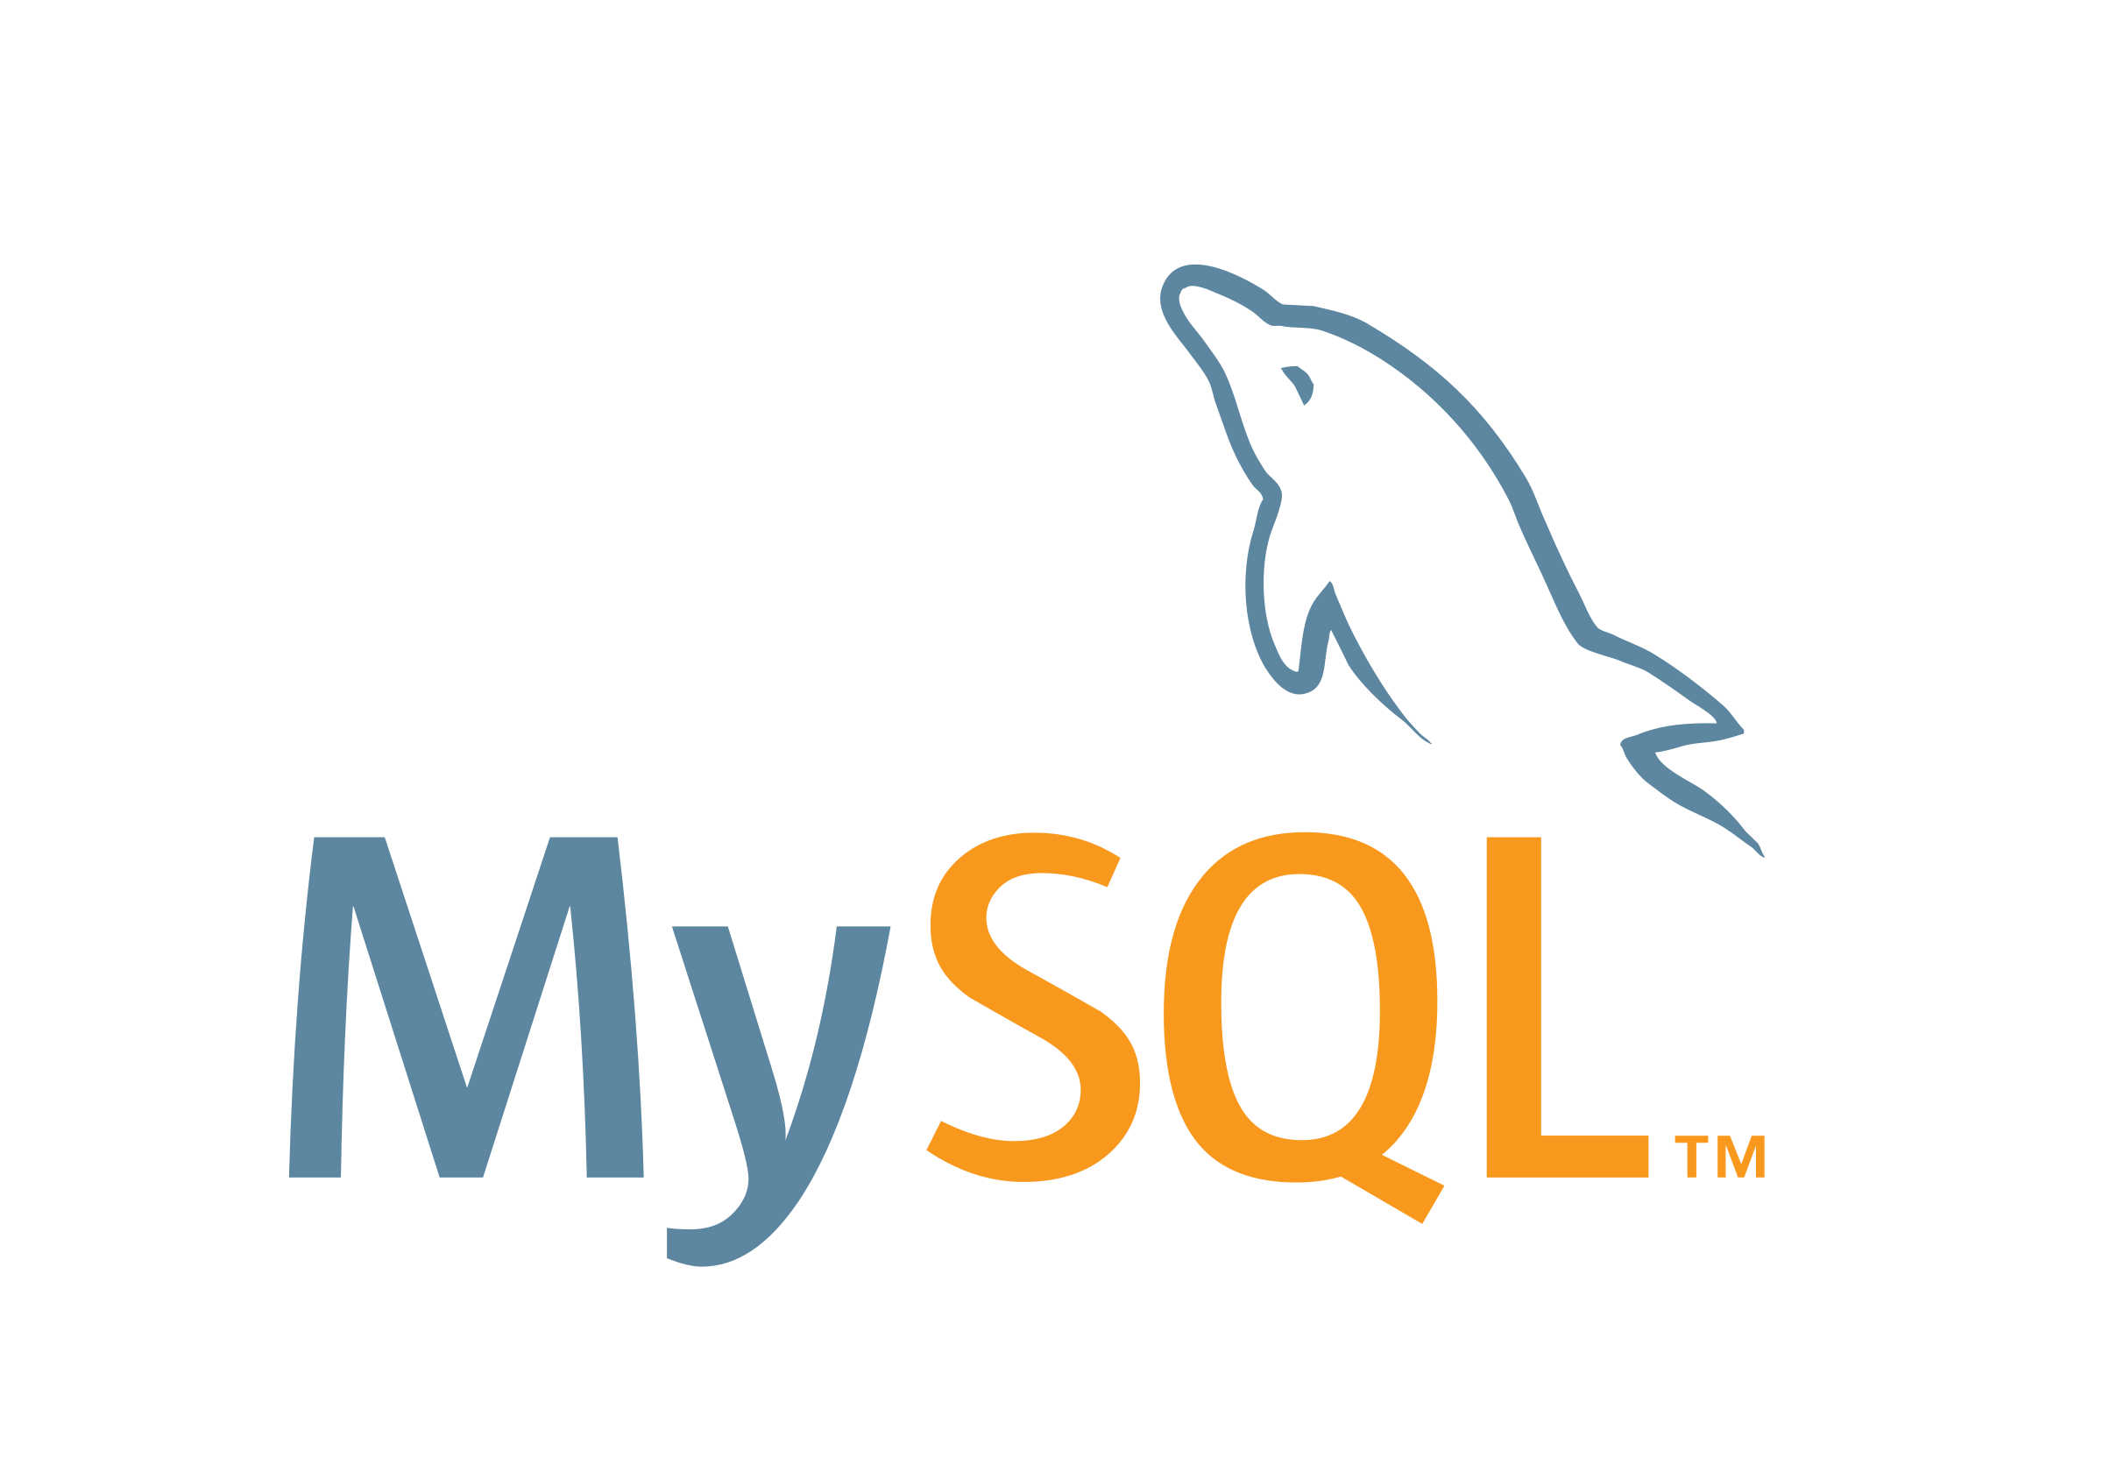
Tech-stack used
Used MySQL Community Server - GPL Version 8.0.36.0 and Connector Version C++ 8.0.36.0 for creating my project as MySQL Community Server - GPL is a free and open-source relational database management system that uses SQL.

Slide 6
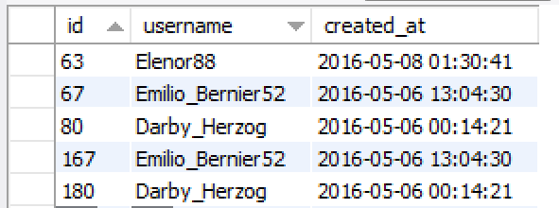
Insights : Marketing
# 1.Rewarding Most Loyal Users:
People who have been using the platform for the longest time. SELECT id, username, created_at FROM users ORDER BY created_at LIMIT 5;
The 5 oldest users of the Instagram from the database are :

Slide 7
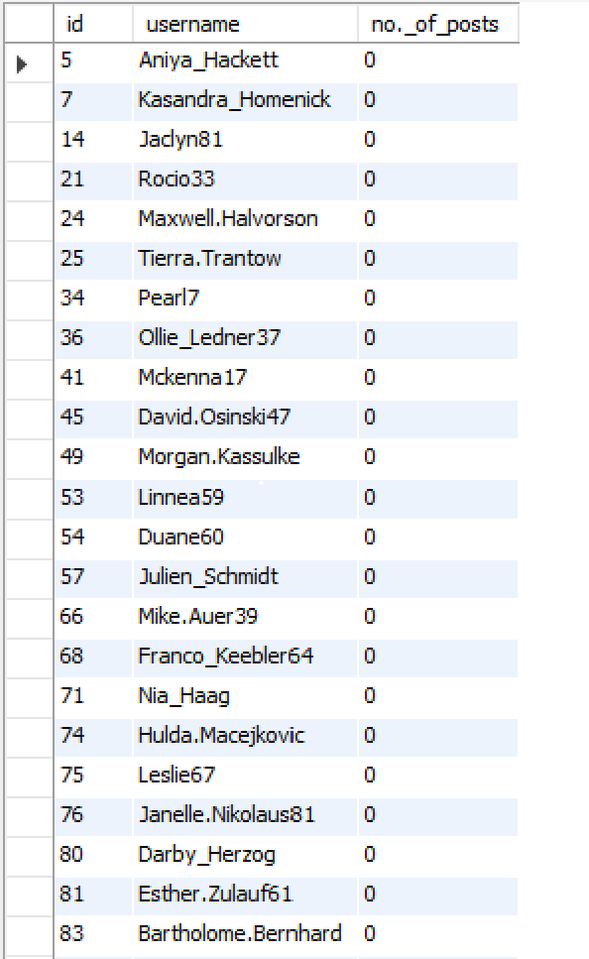
Insights : Marketing
# 2.Remind Inactive Users to Start Posting: By sending them promotional emails to post their 1st photo. SELECT u.id, u.username, Count(p.user_id) AS 'no._of_posts’ FROM users u LEFT JOIN photos p ON u.id = p.user_id GROUP BY u.id HAVING Count(p.user_id) = 0;
The users who have never posted a single photo on Instagram:

Slide 8
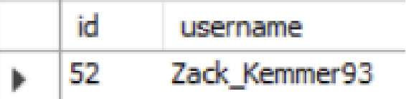
Insights : Marketing
# 3.Declaring Contest Winner: The team started a contest and the user who gets the most likes on a single photo will win the contest now they wish to declare the winner. SELECT id, username FROM users WHERE id = (SELECT user_id FROM photos WHERE id = (SELECT photo_id FROM likes GROUP BY photo_id ORDER BY Count(photo_id) DESC LIMIT 1));
Details of the winner of the contest are :

Slide 9
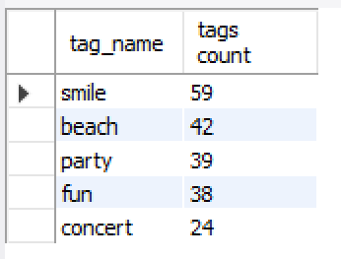
Insights : Marketing
# 4.Hashtag Researching: A partner brand wants to know, which hashtags to use in the post to reach the most people on the platform. SELECT t.tag_name, Count(t.tag_name) AS "tags count" FROM tags t INNER JOIN photo_tags ph ON t.id = ph.tag_id GROUP BY t.tag_name ORDER BY Count(t.tag_name) DESC LIMIT 5;
The top 5 most commonly used hashtags on the platform are

Slide 10
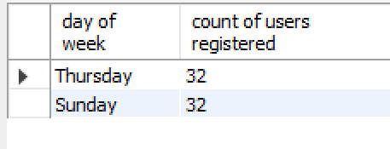
Insights : Marketing
# 5.Launch AD Campaign: The team wants to know, which day would be the best day to launch ADs. SELECT Dayname(created_at) "day of week“, Count(Dayname(created_at)) "count of users registered" FROM users GROUP BY Dayname(created_at) ORDER BY Count(Dayname(created_at)) DESC LIMIT 2;
Day of the week do most users register on :

Slide 11
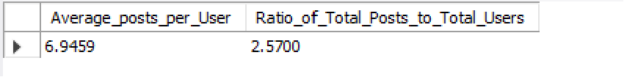
Insights :INVESTOR METRICS
# 1.User Engagement:
Are users still as active and post on Instagram or they are making fewer posts. SELECT (SELECT Count(id)
FROM photos) / (SELECT Count(DISTINCT user_id)
FROM photos) AS Average_posts_per_User,
(SELECT Count(id)
FROM photos) / (SELECT Count(id)
FROM users) AS Ratio_of_Total_Posts_to_Total_Users;
Average user posts and ratio of total posts to total users in Instagram are :

Slide 12
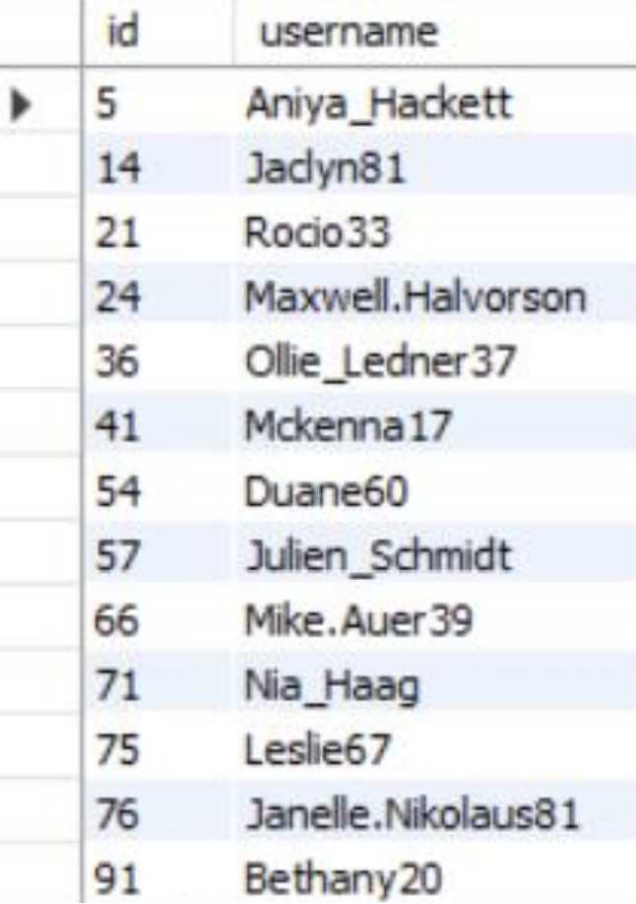
Insights :INVESTOR MATRICS
# 2.Bots & Fake Accounts: The investors want to know if the platform is crowded with fake and dummy accounts. SELECT id, username FROM users WHERE id IN (SELECT user_id FROM likes GROUP BY user_id HAVING Count(user_id) = (SELECT Count(id) FROM photos));
Data of users (bots) who have liked every single photo on the site (since any normal user would not be able to do this) are :

Slide 13
Results
Learnt fundamentals of data analysis using SQL queries to extract insights from database by which we track how users engage and interact with our digital product (software or mobile application) in an attempt to derive business insights for marketing, product & development teams.
Conclusions from above analysis :
Marketing team can reward the most loyal customers, send promotional emails to inactive users, use popular hashtags and most active day for brand promotions.
User engagement can be very useful growth success metric for the company.
Company can remove the bots and fake accounts from the platform to enhance the user experience

Slide 14
Thank
thank
Thank
You
You
You
you
Thank you

